Slide 1
PMOD2BNC
ArtyS7 Peripheral PCB Design

Slide 2

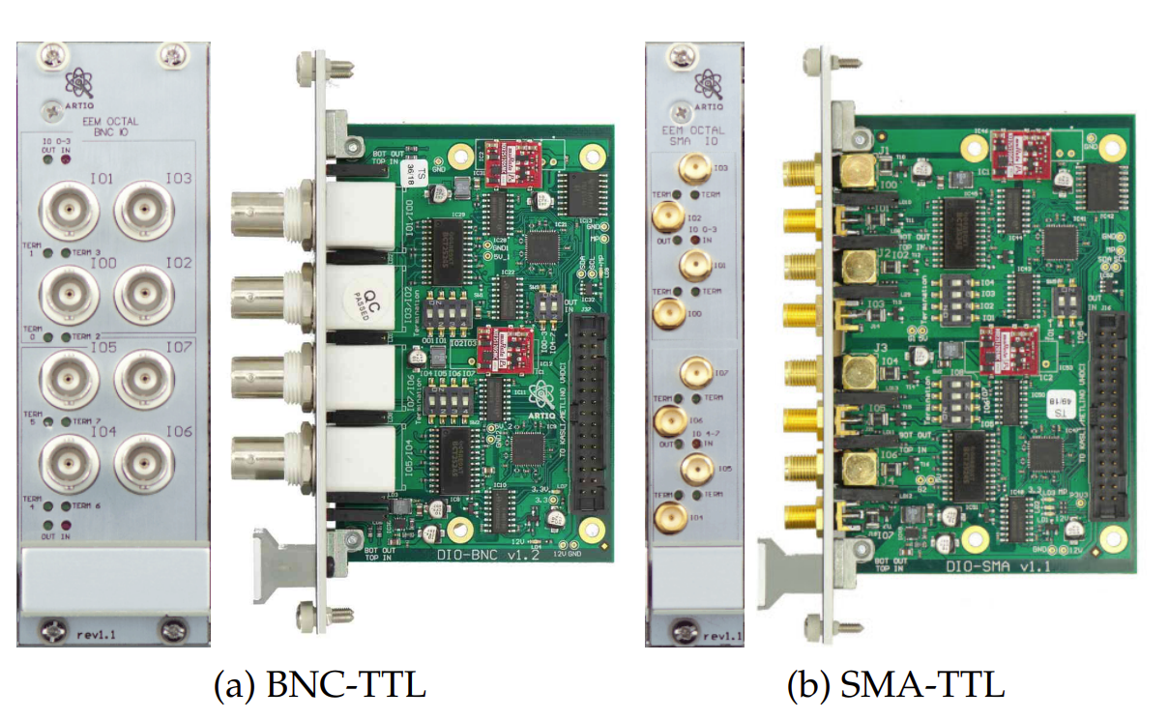
Used Tools & Referenced board
Cadence Orcad 16.6
M-labs TTL board

Slide 3
Difference
 | QuIQCL | M-labs
IO impedance | 50/High Z Selectable | 50/High Z Selectable
Output Voltage | 3.3/5 V Selectable | 5V
Maximum Data Rate | ~100MHz | ~100MHz
Supply Voltage | 3.3V from FPGA 12V from External | 12V from Kasli
Output Port Type | BNC | BNC/SMA
Isolation | Yes | Yes

Slide 4
Simplified Architecture
SPDT
Voltage Select
5V
Isolator
3.3V
molex pin
BNC
Isolator
Transceiver
ESD
50 Ohm

Slide 5
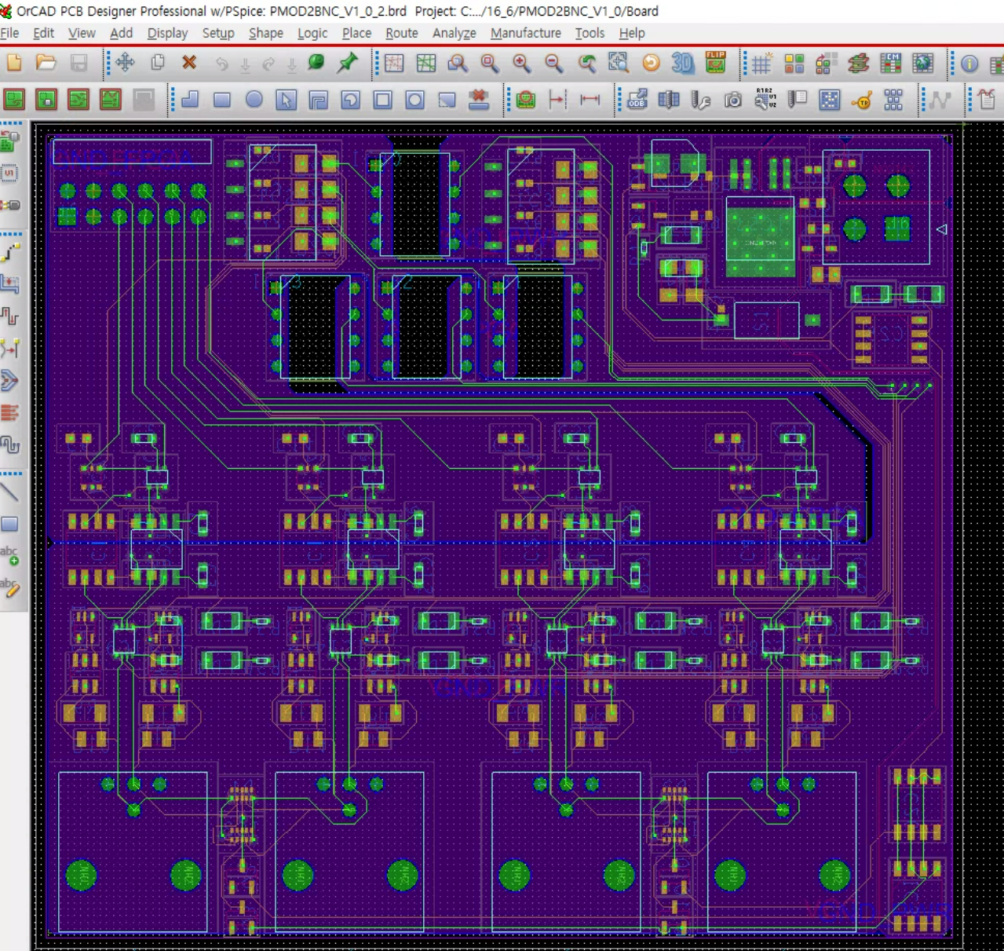
Current Process

Slide 6
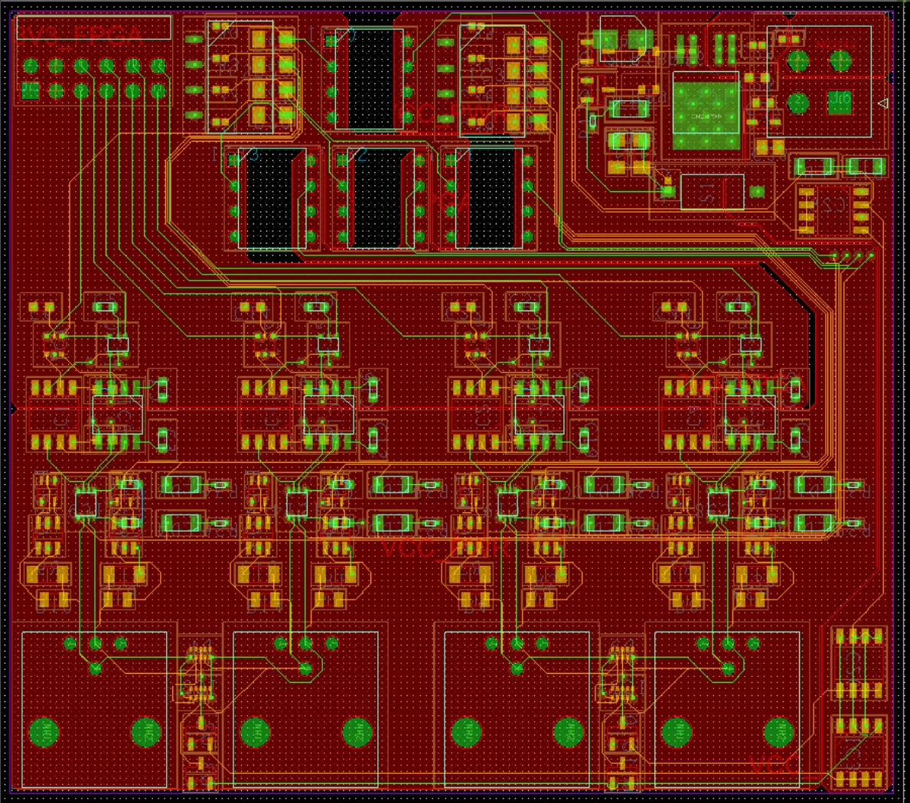
VCC Separation due to Current

Slide 7
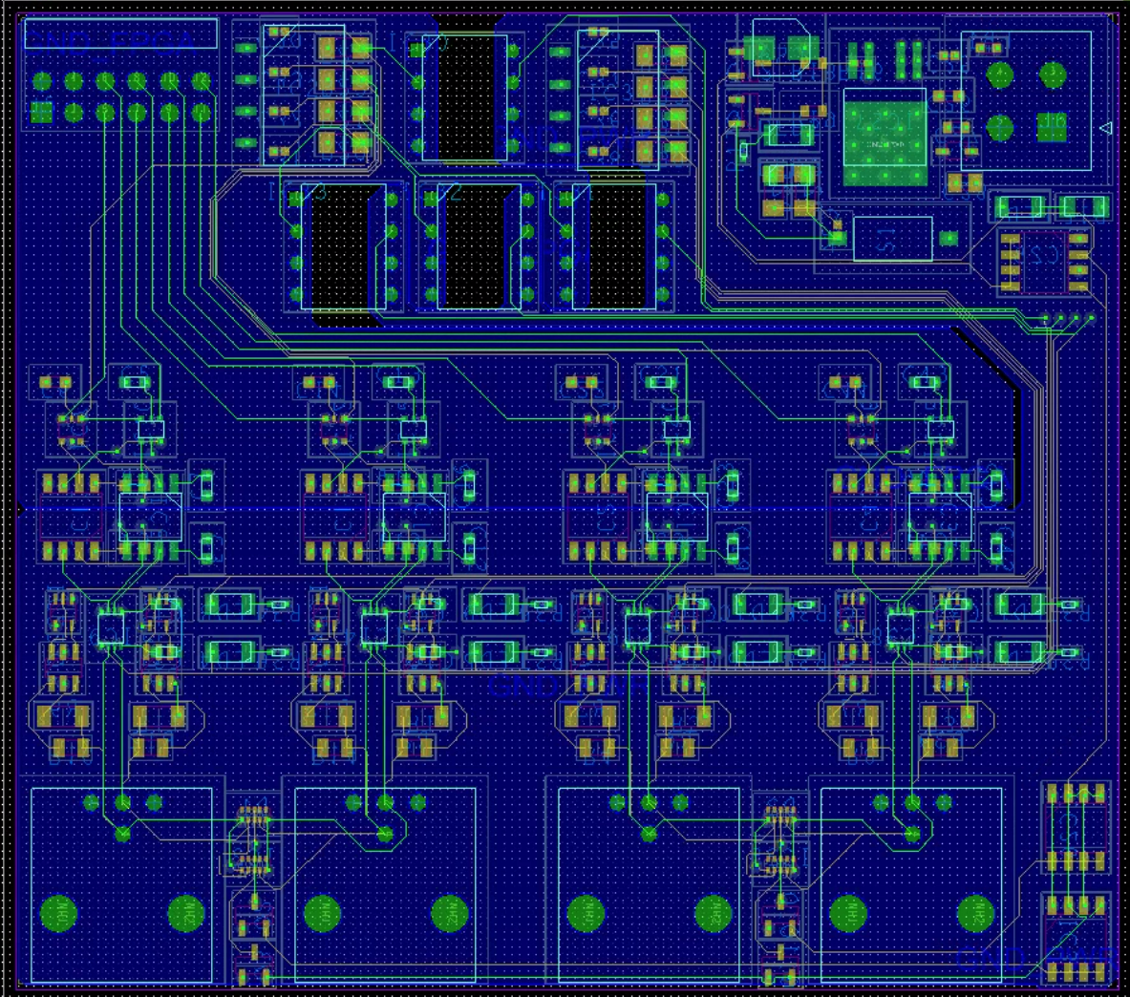
GND Seperation

Slide 8
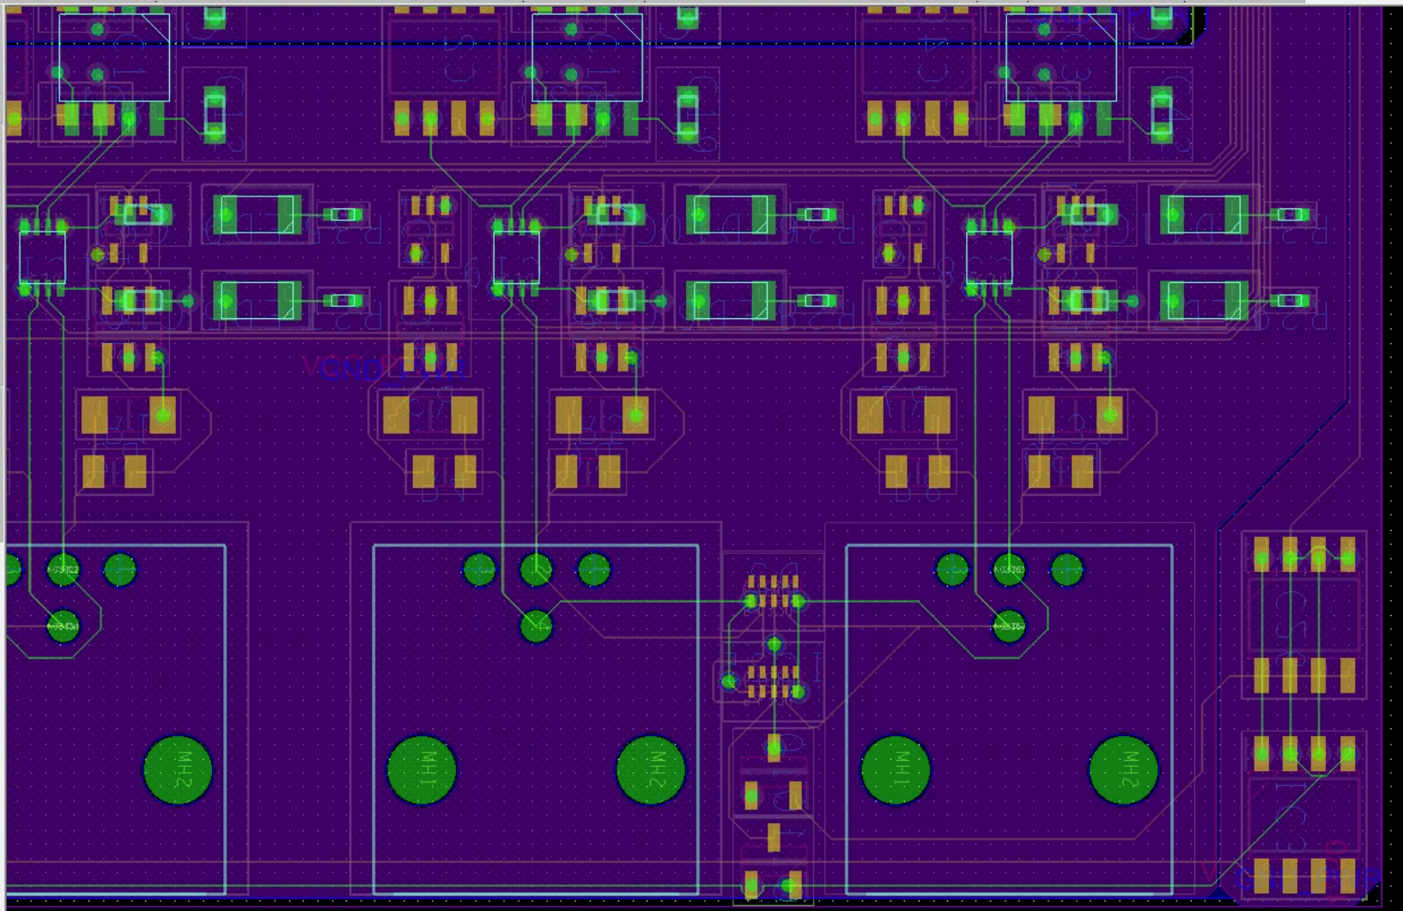
Termination

Slide 9
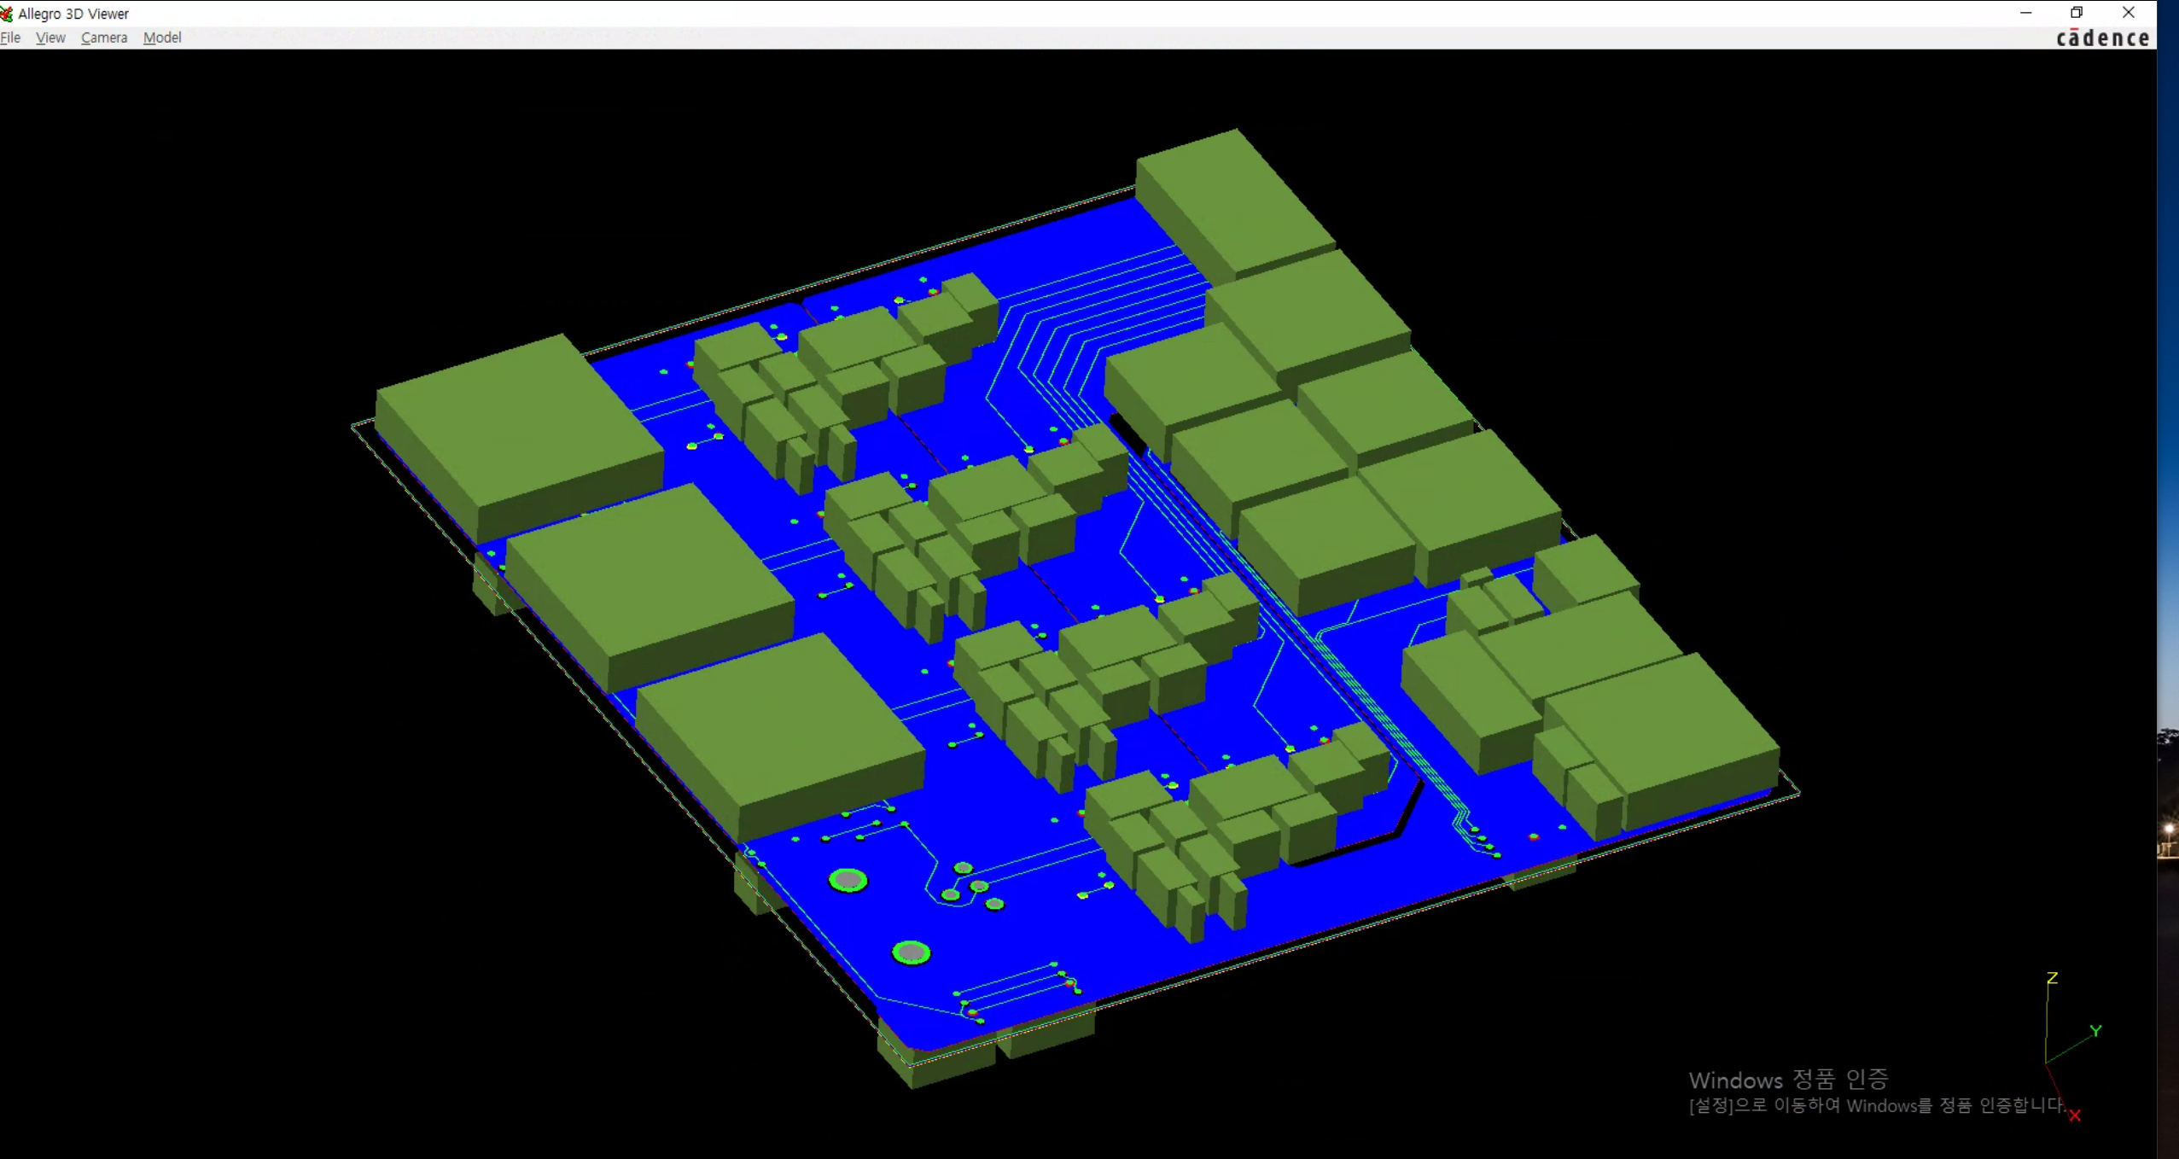
In 3D

Slide 10
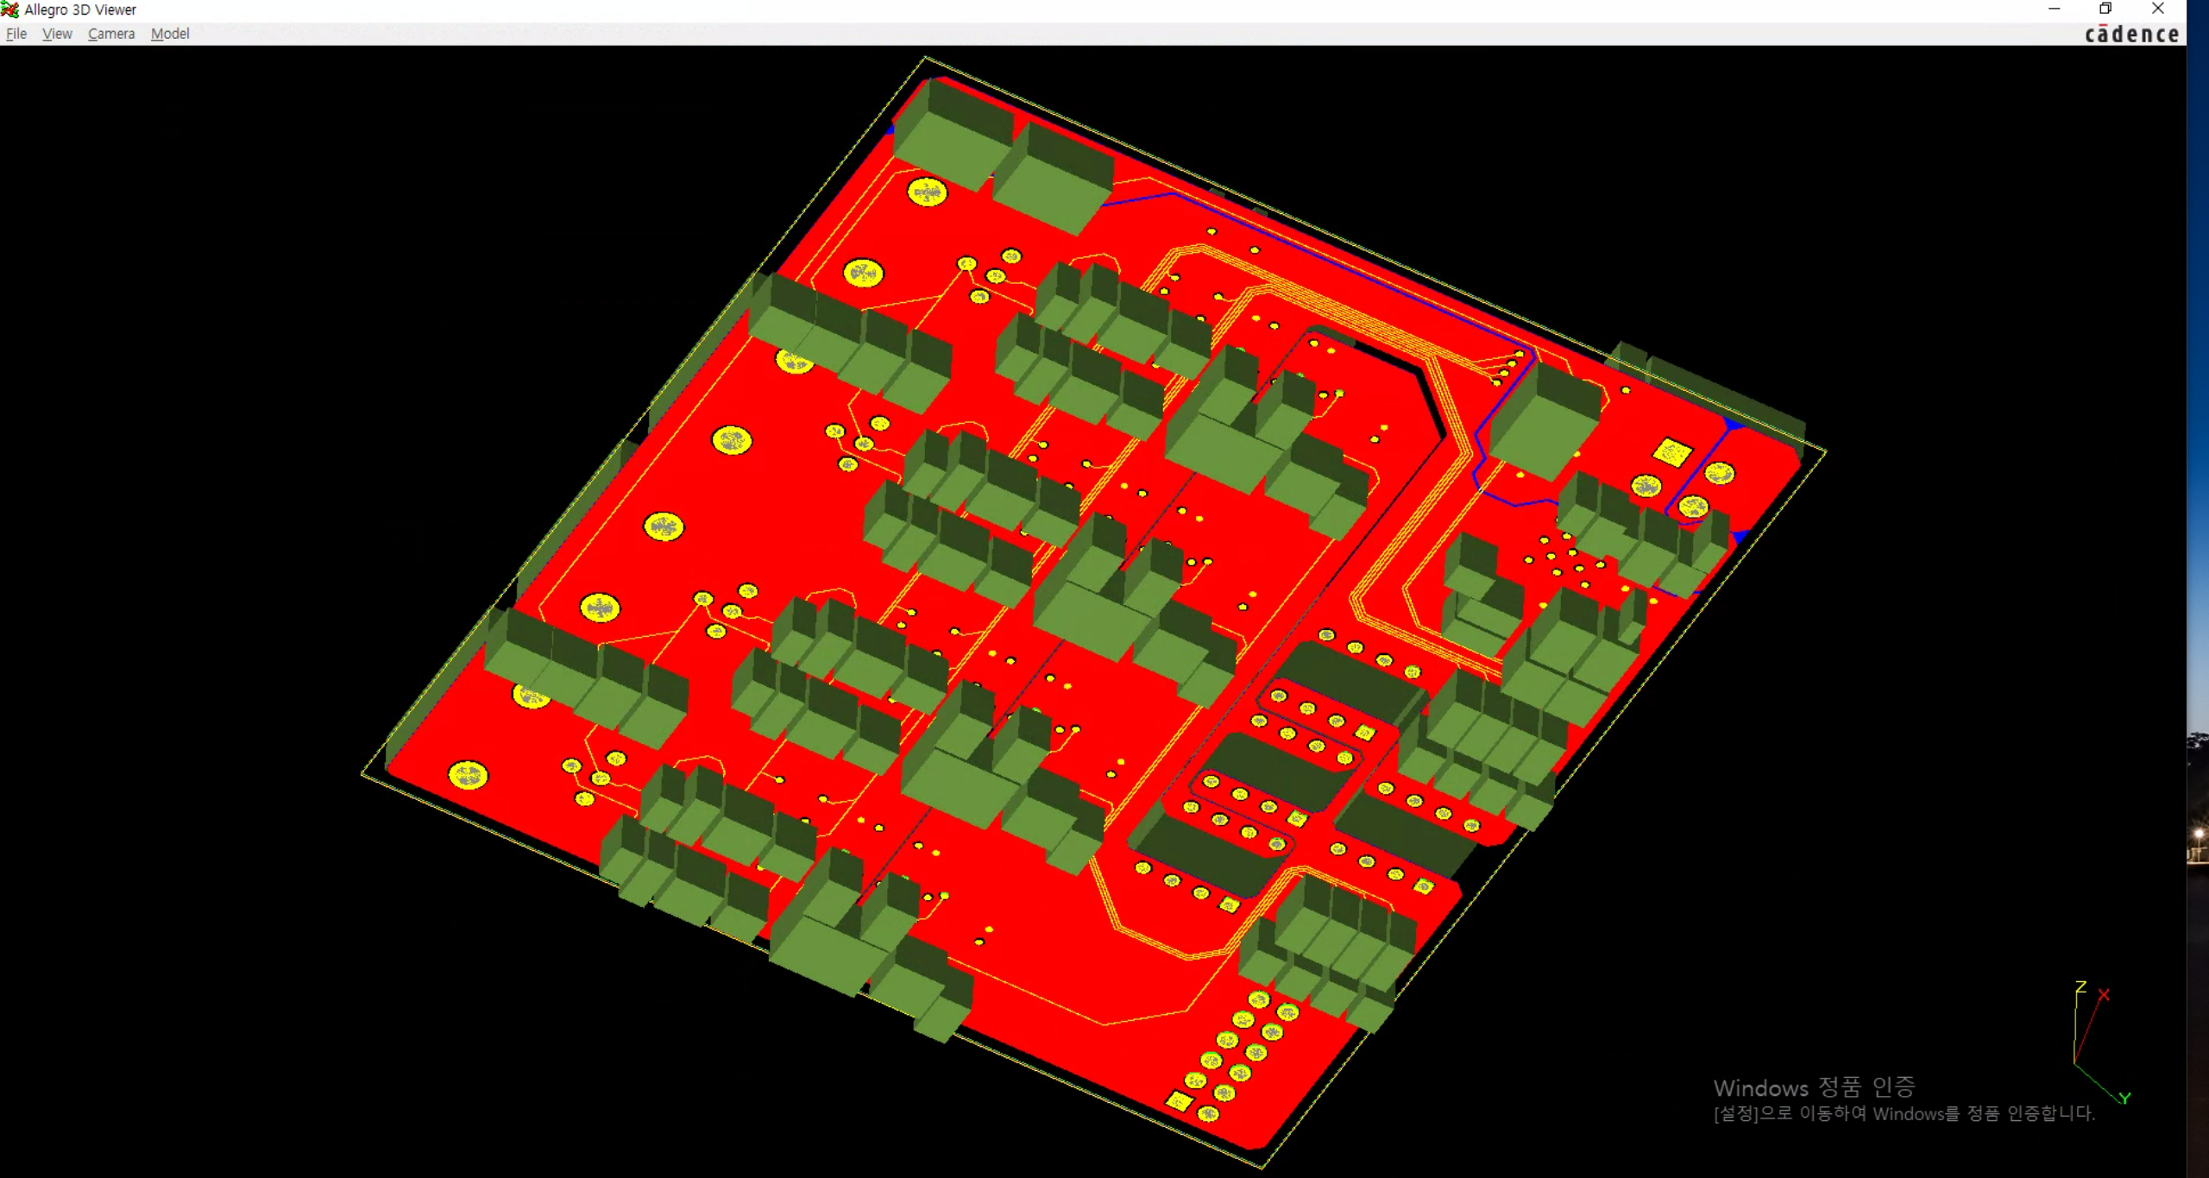
In 3D

Slide 11
ToDo
Delay tuning
PCB thickness setting

